Slide 1
BIOCHEMISTRY ANALYZERS Colorimeter Spectrophotometer Semi Auto-Analyzer Fully Auto-Analyzer Chemiluminescence Immuno-Assay Analyzer Dry Chemistry Analyzer
Name: GOYANI RACHNA RUPARELIYA NIKITA AMBHETIA VAISHNVI PATEL ROJMEENA VORA BHAVIKA KOTADIYA MANALI BORSE BHAVINEE PATEL NENCY

Slide 2
COLORIMETER
To Estimate density of colour.
For colorimetric estimation , substrate must participate in reaction and must produce colour compound.
Coloured substance absorb light in relation to
their colour density.
The colour density will be proportional to the concentration of substance.

Slide 3
PRINCIPLE OF COLORIMETER
Beer’s law and Lambert’s law.
When a monochromatic light passes through a coloured solution, that monochromatic light is absorbed by coloured solution ,which is depend on
type of colour
colour density
distance travelled by light

Slide 4
Beer’s law and Lambert’s law.
The working of colorimeter & Spectrometers is based on Beer's & Lambert's law.
Beer's Law:-It states that the optical density of a solution is directly proportional to the concentration of the solution.
Lambert's law:-It states that the optical density of a coloured solution is directly proportional to the path of light.
O.D. = 2 – log T%
T = transmission According to Beer's & Lambert's law.

Slide 5
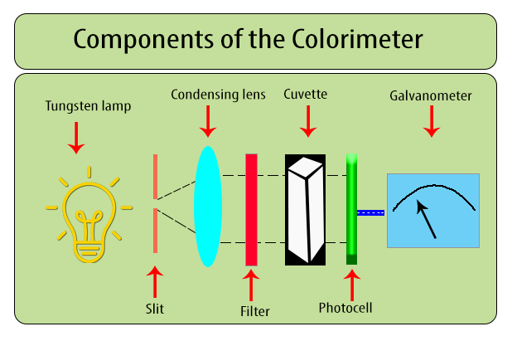
COMPONENT OF COLORIMETER
Light source
Slit
Monochromator(filter)
Cuvette
Photocell
Galvanometer

Slide 6
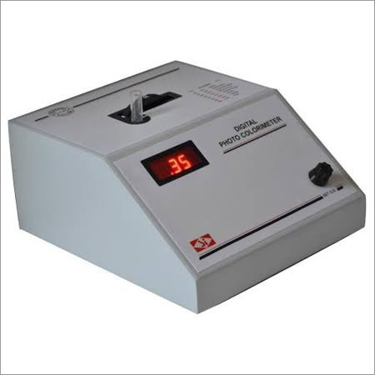

Slide 7
FUNCTION OF EACH COMPONANT
Light source
Two kinds of lamp:-
1.Halogen Deuterium :-
Can use for measurement in the ultraviolet range
200 – 900 nm.
2.Tungsten lamp:-
For visible and near-infrared ranges.
400– 760 nm

Slide 8
MONOCHROMATOR(FILTER) :
FILTER:
Used for selecting the monochromatic light.
Filters will absorb light of unwanted wavelength and allow only monochromatic light to pass through.
Three Types
Glass
2. Grating
Prism

Slide 9
GLASS FILTER
Glass filters are selectively transmit light in particular range of wavelength.
Glass give fixed wavelength of light.

Slide 10
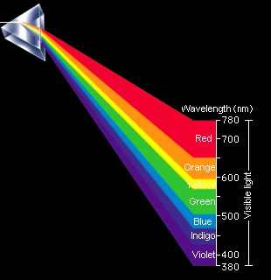
PRISM

Slide 11
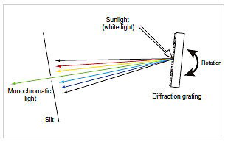
GRATINGS
Light (Tungsten light) is reflected on graphite.
This graft separate light in different wave length . By rotation of slit, desirable wave length of light come out from slit.

Slide 12
Wavelength Spectrums Colour & Substrate Colour
Filter (nm) | Filter color | Absorbed color | Color of solution to be analyzed
340 | UV(colorless) | UV(colorless) | Nucleic acid,Reducing Equivalent
405 | Violet | Violet | Yellow green
450 | Blue | Blue | Yellow
505 | Bluish-green | Blue-green | Red
546 | Green | Green | Red-violet
578 | Yellow | Yellow | Violet
630 | Orange | Orange | Greenish blue
670 | Red | Red | Blue green

Slide 13
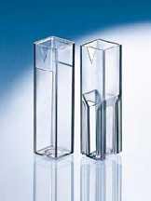
CUVETTE
As per Lambert – beer's law path length is fixed to 1 cm.
Sample cell has 1 cm diameter.
THREE TYPES OF CUVETTE:-
Glass
Quartz
Plastic cuvette

Slide 14
Glass Cuvette
Glass 340nm wavelength of light absorbed in glass cell
So affect the result measured with 340nm filter
Cheap
Quartz
It allows passage both type of light.
Ultraviolet & visible ranges.
So used for measurement of both ranges.
Expensive
Plastic cuvette
Shorter Life Span
Easily get Scratches
Low Cost

Slide 15
PHOTOCELL (PHOTODETECTOR)
These are the devices to measure the intensity of light by converting light energy in to electric energy.
They are made up of light sensitive material such as selenium.
GALVANOMETER
Read-out device.
Used to detect and measure electrical current produced by the photodetector.

Slide 16
Advantage of Colorimeter
Very small
Very cheap
Disadvantage of Colorimeter
Less sensitive.
Limited range of filters are available.
Manual operation.
Diameter of test tube may be different with different test tube.
If the light source is not stable ,there is a possibility of errors due to a change from the initial light intensity during a measurement.

Slide 17
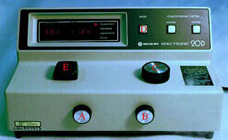
SPECTROPHOTOMETER

Slide 18
Colorimeter vs spectrophotometer
Colorimeter
Limited for visible portion of spectrum
Cheap
2 digit reading after decimal point
Less sensitive
Glass are used
Tungsten lamps are use
Can’t use specific filter
Spectrophotometer
Ultraviolet & infrared region also visible
very costly
4 digit reading after decimal point
More sensitive
Prism are used
Halogen lamps are use
Can use specific filter

Slide 19
Auto analyzers are mainly two types:-
Semi Auto Analyzer
Fully Auto Analyzer

Slide 20
Semi Auto Analyzer
Advantage :
Displaying the test results
Printing & memorizing these results
Graphs of all linear & nonlinear reactions.
Disadvantage :
Initial stage of analysis are performed manually , like
Pipetting of reagent
Pipetting of specimen
Mixing & incubation.
This instrument require minimum 500 microliters of reagent for test. More consuption of reagent & sample
More man power require
Manual L-J chart to draw

Slide 21
Fully auto analyzer

Slide 23
Fully Auto Analyzer
Automatic dispensing of reagent & sample
Automatic mixing & incubating of reacting mixture.
Less requirement of reagent , sample & man-power
Automation for running , analyzing and interpretation of quality control data
Drawing of L-J charts
Calculation of Mean , S.D. , CV%
Automated calibration of analytes.
6. Programmable wash cycles between samples & tests for
minimum carry over.
7. Auto dilution is also possible
8. Facility to store all data related to
Patient result
QC
Calibration
Maintenance
Troubleshoot

Slide 24
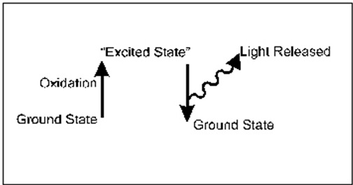
Principle- Chemiluminescence
Chemilluminescence occurs when there is emission of light when an electron returns from an excited or higher energy level to a lower energy level.
Excitation event is caused by chemical reaction.
Light can be emitted in the ultraviolet, visible or infrared reagion.
In Chemiluminescence heat is not produced also called “cool light”.

Slide 25
Chemiluminescence Immuno Assay(CLIA)
Chemiluminescence Immuno assay convert a substrate to a reaction products, which emits a photon of light instants of developing colour.
Chemiluminescence is the emission of light as the result of a chemical reaction.
[A]+[B] → [O] → [Product]+[light]
Luminol + H₂O₂ →3-APA[O] → 3-APA + Light
3-APA = 3-aminophthalate
Light is emitted from the excited product formed.

Slide 27
chemilumiescence occurs in the presence of a CATALYST:
Enzymes
eg., -Alkaline phosphates
-Horseradish peroxidase
-Microperoxidase
Metal ions
-Metal complexes
eg., -Cu²⁺ & Fe⁺³
- Phthalocyanine complex

Slide 28
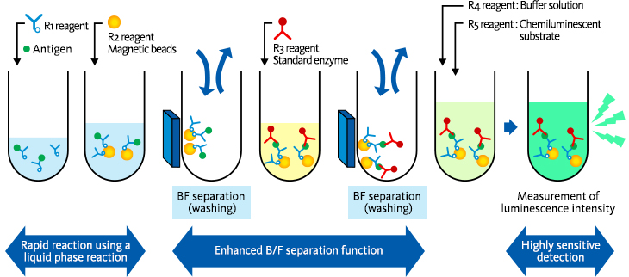
Magnetic CLIA
In this sandwich technique the analyte is sandwiched between antibody substrate conjugate and antibody magnetic particle.
The analyte is bound to both conjugates, the unbound conjugates are washed out using magnetic separation technique.
Conjugate analyte sandwich between substrate and magnetic particle is incubate with oxidant enzyme and amount of Chemiluminescence is quantified.

Slide 29
ADVANTAGES
Sensitive & Specific in compare ELISA
Linear response
High stability reagent
Fast emission of light
Short incubation period
Absence of toxicity
Mainly use for Immunology , serology & hormone analysis test
DISADVANTAGES
Not useful for routine biochemistry parameter
Costly in compare to ELISA

Slide 30
Uses of CLIA /ECLIA / MCLIA
Immunology & serology test
IgE
IgM
Hormone analysis
Estradiol
Insulin
Beta HCG
LH
FSH
Tumour markers
CA-125
Prostate specific antigen
Acid phosphaste
For DNA analysis, DNA finger printing, DNA sequencing, shourthen blotting and electro photogram.

Slide 31
Dry Chemistry Cartridge Layer

Slide 32
Principle & Use of Different Layer Dry Chemistry Cartridge
Spreading layer
Sample or Control or Standard apply on this layer.
Spread the sample in specify area only
Content Titanium di-oxide
Reflex light path to photo-detector
Scavenger layer
Remove impurity & inference serum (lipemia , haemolysis)
Not require in every analyte cartridge.
allows selected components to filter through and penetrate to the reaction layer (s)
Component
Resin
Chemical / Enzyme
E.g. Uric acid analyte kit – has ascorbate oxidase

Slide 33
Reagent layer
Contain layer of Lyophilized / Dry enzymes / buffers
different number of reagent layer require in different test as per principle of test
for glucose is one
for uric acid is two
for cholesterol is may three layer.
Indicator layer
Contain colour producing agent
Support layer

Slide 34
Principle of Dry Chemistry Analyzer
Light is pass through
All the layer except spreading layer
As light hits the white spreading layer, some of the light reflects back to a photocell or eletrode while some light is absorbed.
The amount of reflected light, is
Inversely proportional to colour density of reagent layer
Inversely to concentration of the analyte

Slide 35
1)COLORIMETRIC PHOTOCELL
Quantifies enzymes, general chemistry, and immunology
2) POTENTIOMETRIC PHOTOCELL
Each slide have an ion selective film electrode for each of
Na, K, and Cl and electrolytes.

Slide 36
ADVANTAGES
Very good stability of reagent
Available in form of cartridge so minimum storage place require – reduce cost of storage.
More precision – due to stability of reagent
Less - NIL water requirement
Less biomedical waste generation
Less consumable require in instrument .
Less instrument maintenance require.

Slide 37
DISADVANTAGES
Instrument is costly
Sample with abnormal high protein may introduce significant errors.

Slide 38
THANK YOU..

